Slide 1

EC7206 – IMAGE CRYPTOGRAPHY USING ECC AND MAGIC MATRIX
GROUP MEMBERS:
DERIL RAJU (BE/10489/16)
MUPPIDI SAI PRANAV (BE/10488/16)
LALITHA ELESWARAPU (BE/10435/16)

Slide 2
Contents
Objective
Block Diagram of system
Elliptic Curve Cryptography
  Introduction
  Advantages and applications
  Process flowchart
Magic Matrix
  Construction
  Implementation
AES Method
  Why AES?
  Methodology
References
Future work

Slide 3
Introduction
Image Cryptography is a widely used technique which has found great application in the fields of military and intelligence, social networking and financial services.
The main motto of cryptography is to service the growing need for increased security of information in various fields.
Objective
To design an efficient encryption/decryption scheme using Elliptic curve cryptography and Magic matrix scrambling technique with the help of AES encryption.

Slide 4
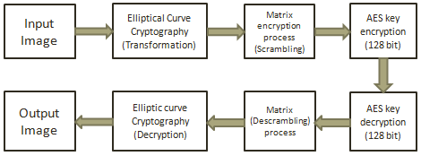
BLOCK DIAGRAM OF ENCRYPTION AND DECRYPTION
Encrypted Image
Decrypted Image

Slide 5
Introduction to Elliptic Curves
Elliptic Curve (EC) systems as applied to cryptography were first proposed in 1985 independently by Neal Koblitz and Victor Miller.
An elliptic curve over a field K is a nonsingular cubic curve in two variables, f(x,y) =0 with a rational point (which may be a point at infinity).
The field K is usually taken to be the complex numbers, reals, rationals, algebraic extensions of rationals, p-adic numbers, or a finite field.

Slide 6
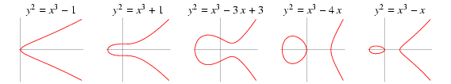
General form of an Elliptic curve
An elliptic curve is a plane curve defined by an equation of the form
Examples:

Slide 7
Advantages and Applications of ECC
The principal attraction of ECC compared to RSA is that it offers equal security for a smaller bit size, thereby reducing processing overhead.
ECC is ideal for constrained environment such as pager, PDAs, cellular phones and smart cards.
ECC is also applied in wireless communication devices and smart cards.
To protect a 128 bit AES key it would take a:
  RSA Key Size: 3072 bits
  ECC Key Size: 256 bits
Shorter key lengths lead to speeding up of encryption and saving of storage and bandwidth resources.

Slide 8
Koblitz Method for Encoding pixel intensity values
Encoding:
Step1: Pick an elliptic curve Ep(a,b).
Step 2: Let us say that E has N points on it.
Step 3: Our input(message) is an image which has to be converted into a matrix of pixel intensity values.
Step 4: Doing this converts our message into a series of numbers between 0 and 255.
Step 5: Now choose an auxiliary base parameter, for
example k = 20. ( both parties should agree upon this)
Step 6: For each number mk (say), take x=mk + 1 and try to
solve for y.

Slide 9
Koblitz Method for Encoding pixel intensity values(cont.)
Step 7: If you can't do it, then try x = mk +2 and then x = mk
+3 until you can solve for y.
Step 8: In practice, you will find such a y before you hit x = mk + k - 1. Thus we obtain a point (x,y) on the elliptic curve which now represents a value in the input matrix. In this way, the entire message becomes a sequence of points.
Step 9: We transmit a matrix of ‘y’ values to the receiver section and recover values of x using the elliptic curve equation.
Decoding:
Consider each point (x,y) and set m to be the greatest integer
less than (x-1)/k. Then the point (x,y) decodes as the symbol
m.

Slide 10
Process Flowchart
Start
Represent the image as a matrix of pixel intensity values
Recover the values of x co-ordinate using the elliptic curve equation
Using Koblitz method, encode these values to points on the elliptic curve
Decode the point to it’s corresponding pixel intensity value
Transmit the values of y co-ordinate in the form of a matrix
End

Slide 11
Example of implementation
Say the parameters of curve are:
p(751),a(-1),b(188),n(727).
Say we have a pixel intensity value of 11. Consider m=20.
x=mk+1 i.e. 11*20+1=221 we cannot solve for a y such that y^2= x^3 + ax+ b mod p .
So go for x=mk+2 , x=222 , we find that no y exists. Similarly for x=mk+3, x=223, no y exists.
At x=mk+4, x=224, we find that y=248.
Now the point (224,248) represents a pixel intensity of 11 on the elliptic curve
To decode just compute (x-1)/k i.e. (224-1)/20=223/20 i.e. 11.15.
Return 11 as original value i.e. greatest integer less than(x-1)/k = 11.
The probability that we fail to find a square (and hence fail to associate m to a point) is about 1/2^k.

Slide 12
MAGIC MATRIX
These methods of scrambling often did tricks like changing the order of the video scan lines so that the image could not render properly.
Instead of actually protecting the data lines, data scrambling seeks to just obfuscate the data.

Slide 13
CONSTRUCTION OF MAGIC MATRIX
Proposed method:
To define the mapping matrix, the elliptic group Ep (a, b) which is all possible points on the finite field are generated first and the original image is divided into data matrices of 8x8. The row indexes are starting from 0 and end with 63 for the first matrix, from 64 to 127 for the second and so on.
Then, encrypt the image based on the steps discussed. The encrypted image is transmitted to the receiver. The receiver will decrypt the image by the reverse process of the encryption.
The encrypted image provided by the algorithm is different from the plaintext image so we can securely transmit over the internet

Slide 14
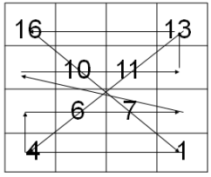
CONSTRUCTION OF MAGIC MATRIX
Start in the bottom right corner of the grid, and count along, but only put the numbers you count on the diagonal lines. i.e. follow the path marked out below, putting numbers on the diagonals

Slide 15
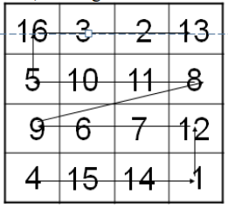
CONSTRUCTION OF MAGIC MATRIX
Next, starting at the bottom left, count backwards from 16, putting the numbers in the blank spaces.
If the image size is large we should make the images into parts and then we should represent each part as a matrix.

Slide 16
Why AES?
It uses higher length key sizes such as 128, 192 and 256 bits for encryption. Hence it makes AES algorithm more robust against hacking.
It is the most common security protocol used for wide various applications such as wireless communication, financial transactions, e-business, encrypted data storage etc.
For 128 bit, about 2^128 attempts are needed to break. This makes it very difficult to hack it as a result it is very safe protocol.

Slide 17
WORKING OF AES
AES repeats 4 major functions to encrypt data. It takes 128 bit block of data and a key and gives a ciphertext as output. The functions are:
I. Sub Bytes
II. Shift Rows
III. Mix Columns
IV. Add Key
The number of rounds performed by the algorithm strictly depends on the size of key.
Key Size(in bits) Rounds
128.................................................10
192.................................................12
256.................................................14

Slide 18
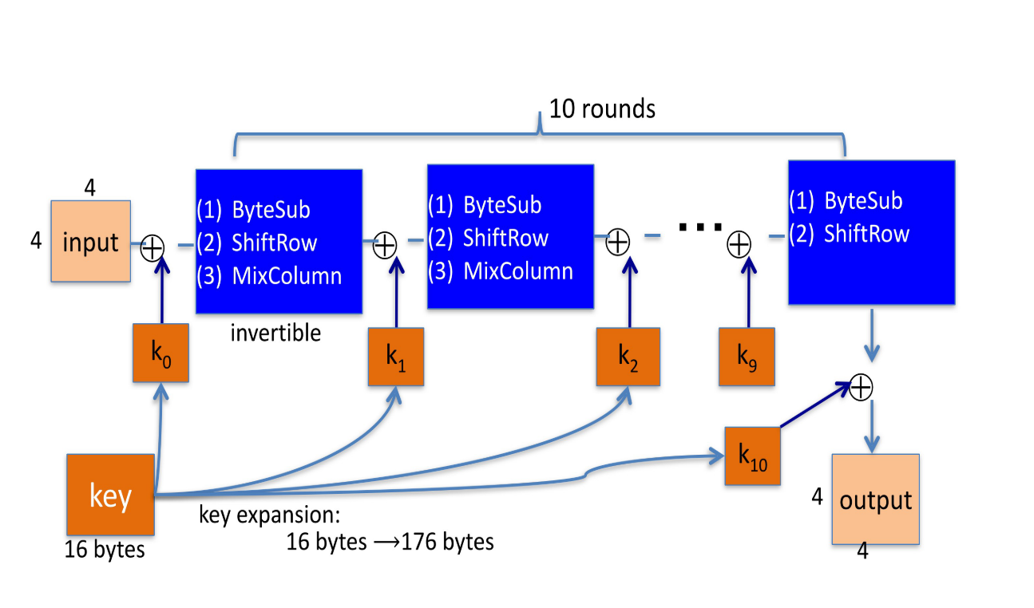

Slide 19
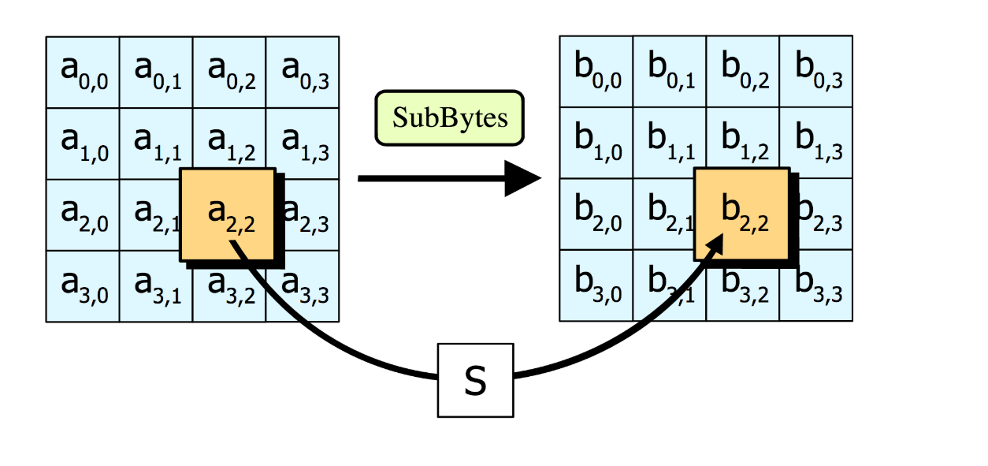
STEP 1: SUB BYTES
Sub Bytes- Each element of the matrix is replaced by the an element of s-box matrix.

Slide 20
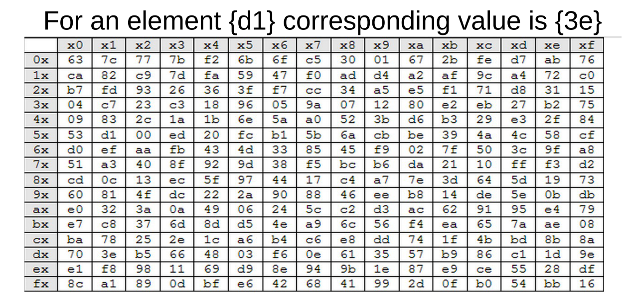
Rijndael S-Box

Slide 21
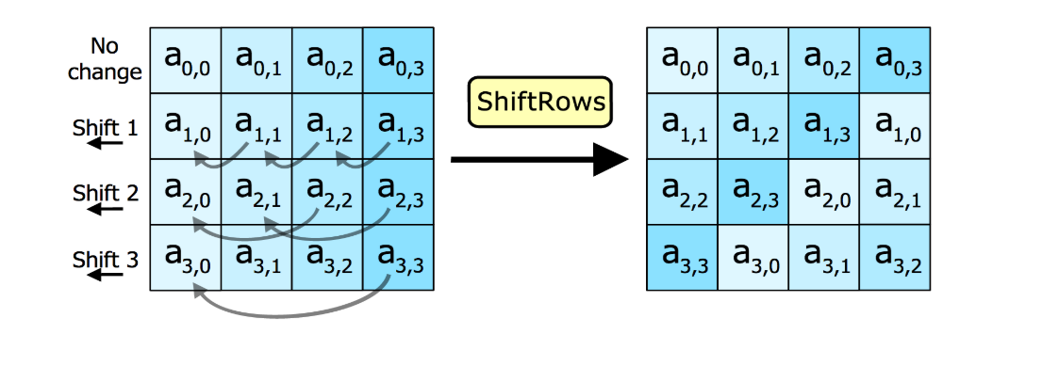
STEP 2: SHIFT ROWS
In this step rows of the block are cylindrically shifted in left direction.
The first row is untouched , the second by one shift, third by two and fourth by 3.

Slide 22
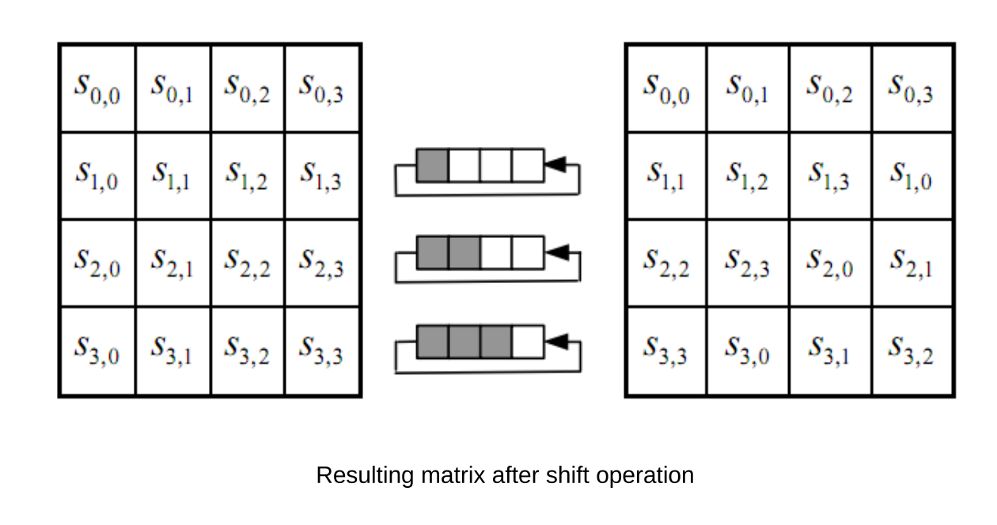

Slide 23
STEP 3: MIX COLUMNS
This is the most important part of the algorithm
It causes the flip of bits to spread all over the block
In this step the block is multiplied with a fixed matrix.
The multiplication is field multiplication in Galois field.
For each row there are 16 multiplication, 12 XORs and a 4-byte output.

Slide 24
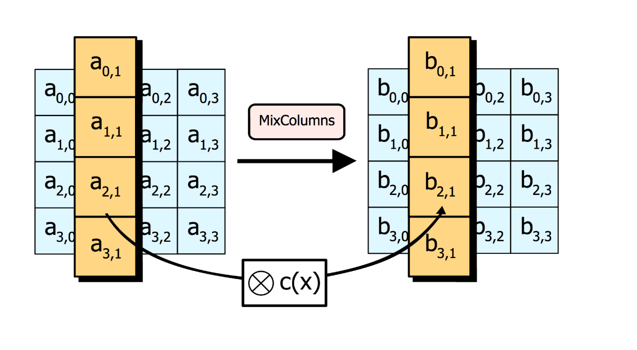

Slide 25
STEP 4: ADD ROUND KEY
In this step each byte is XOR-ed with corresponding element of key's matrix.
Once this step is done the keys are no longer available for this step. Using the same key will weaken the algorithm.
To overcome this problem keys are expanded.

Slide 26
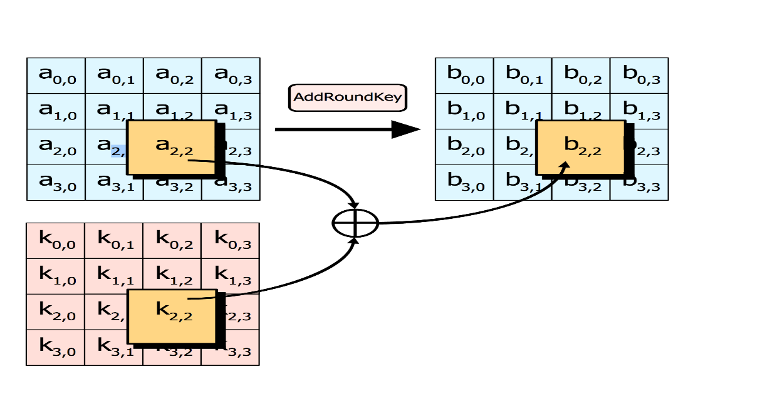

Slide 27
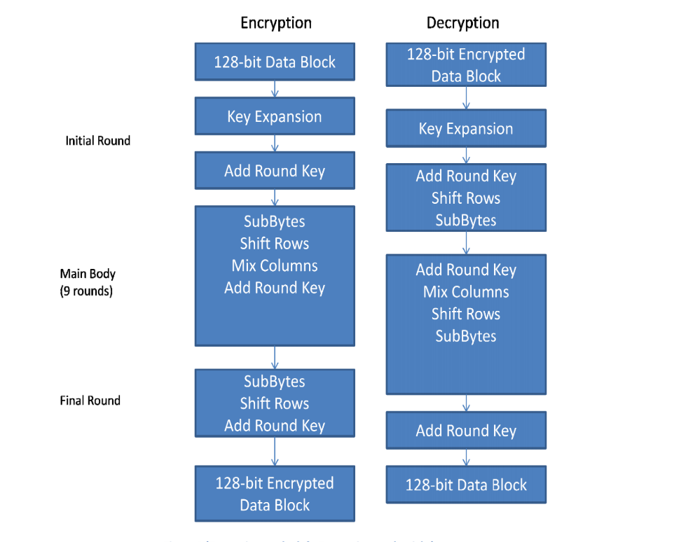
STEPS FOR ENCRYPTION AND DECRYPTION

Slide 28
References
Image encryption using elliptic curve cryptography and matrix
Srinivasan Nagaraj, Dr. GSVP Raju, K Koteshwar Rao
Encoding and decoding of a message in the implementation of elliptic curve cryptography using koblitz method
Padma Bh, D Chandravathi, Prof. P Roja

Slide 29
Future Work
Target before Endsem
Image encryption scheme utilising elliptic curve cryptography
Pixel-scrambling using magic matrix algorithm.
Key encryption using AES technique.
Future Implementations
Decryption of image using the reverse process of all the schemes mentioned above.
Analysis of system performance by comparing original image and decrypted image.

